Slide 1



Plant Robots
Amethyst O’Connell, Junchi Feng, Roman Woolery,
Scott Deyo
Notes:
https://www.businessinsider.com/office-air-co2-levels-making-workers-tired-2017-11

Slide 2
STEMMA
Did not have a datasheet, just a usage guide for the Arduino
Code to run was gross C++ that could not be reverse engineered
Sensor runs off an Atmel Microcontroller, could have any I2C configuration it wants
Advantage is that it’s capacitive, more resistant to corrosion
The soil sensor from hell
Notes:
http://ww1.microchip.com/downloads/en/devicedoc/atmel-42242-sam-d10_datasheet.pdf
https://learn.adafruit.com/adafruit-stemma-soil-sensor-i2c-capacitive-moisture-sensor

Slide 3
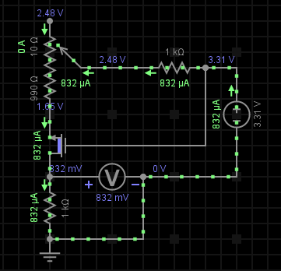
SparkFun Soil Sensor
Analog soil sensor
With testing, were able to adapt the code from Lab 6 to give us a percent moisture readout
Resistive sensor, disadvantage in corrosion
Circuit Diagram, which the PA assisted with, demonstrating why corrosion can cause values to shift over time
Notes:
https://learn.sparkfun.com/tutorials/soil-moisture-sensor-hookup-guide
The PA? It’s Farris, the best PA.

Slide 4
The Struggle
Moisture sensor wouldn’t print above 23.8 percent
Various other display problems
Fixed by rewriting project with simpler code
Getting proper LCD output

Slide 5
Flow Control
Uses the solenoid-controlled flow valve from AdaFruit
Uses latching relay to connect 12V to the solenoid
Firmware latches relay on with 10ms pulse when soil is dry, for a set amount of time (3 seconds in demo), then latches it off, saving power
Valve for slowly releasing water
Notes:
Adafruit Latching 3V Relay, https://www.adafruit.com/product/2923
Adafruit Solenoid Flow Valve, https://www.adafruit.com/product/997

